Slide 1
Capstone Project
Yes Bank Stock Closing Price Prediction Done by: Sananda Biswas Chatterjee & Amit Kundu

Slide 2
CONTENTS
Introduction
Problem Statement
Feature Information in Brief
Step Taken
i. Importing libraries and dataset
ii. Cleaning the dataset
5. Exploratory Data Analysis(EDA)
Model Building
Cross validation & Hyper parameter Tuning
Conclusion

Slide 3
INTRODUCTION
We have a dataset that belongs to the Yes Bank monthly stock prices from the months of July 2005 to November 2020. Due to Rana Kapoor's recent incident of fraud case, the bank has recently been in the news. We should be able to predict the closing price of the bank's stock using the dataset analysis and other factors.
The goal of this study is to test a variety of models to evaluate whether stock prices and movements can be predicted using features and historical data using regression technique. We must first understand the correlations between the various components of the dataset in order to provide the model with the appropriate parameters for training which eventually predict the closing price.

Slide 4
PROBLEM STATEMENT
Yes Bank is a well-known bank in the Indian financial domain. Since 2018, it has been in the news because of the fraud case involving Rana Kapoor.
Owing to this fact, it was interesting to see how that impacted the stock prices of the company and whether any predictive models can do justice to such situations.
This dataset has monthly stock prices of the bank since its inception and includes closing, starting, highest, and lowest stock prices of every month. The main objective is to predict the stock’s closing price of the month.

Slide 5
FEATURE INFORMATION
The YES BANK dataset contains closing, opening, maximum, and lowest stock values for each month over the course of 185 observations. It also includes monthly stock prices for the bank since its founding.
Here is the brief discussion about these features --
Date: Monthly observation of stock prices since it was listed.
Open: The price of a stock when stock exchange market open for the day.
Close: The price of a stock when stock exchange market closed for the day.
High: The maximum price of a stock attained during given period of time.
Low: The minimum price of a stock attained during given period of time

Slide 6
STEP TAKEN
Importing libraries and dataset
Our first step is to import libraries. Libraries to assist us investigate the issue and carry out analysis to make judgments based on a set of data.
We are writing our script for this project using Google Collab. We used Yes Bank Stock Closing Price data that is freely available online under the Creative Commons License in order to obtain the information.

Slide 7
STEP TAKEN
Cleaning the dataset
The data we imported frequently contains variety of issues, like missing values, duplicate values, inaccurate data, etc.
In order to be used for more thorough analysis, the data quality must be raised through cleaning.
After cleaning the data we found no duplicate or null values in our dataset.
We have also checked the outliers.
We updated the date column to the proper format(i.e from Jul-05 to 2005-07-01).

Slide 8
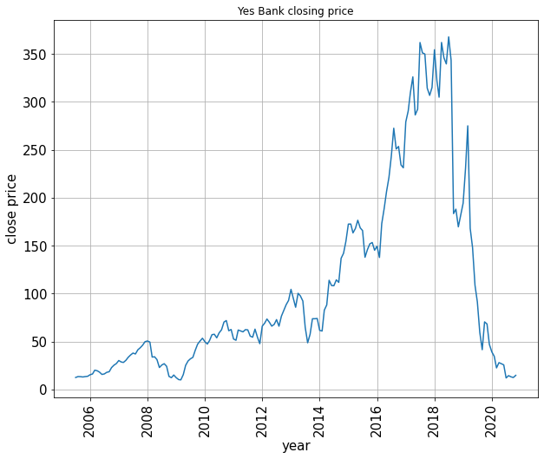
EXPLORATORY DATA ANALYSIS(EDA)
This plot is showing different scenario in different time-duration, we can clearly see that it was continuously increasing from 2009 till 2018. after 2018 there is a sudden fall in the stock closing price due to fraud case of Rana Kapoor.

Slide 9
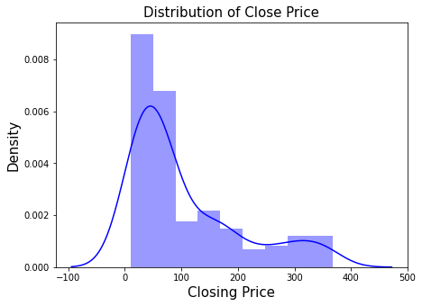
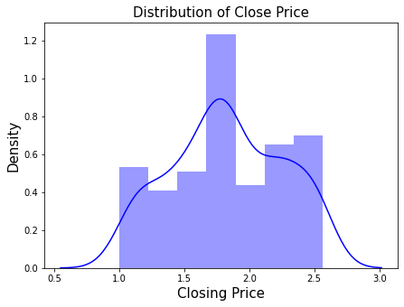
Univariate Analysis
Distribution of dependent variable
After Applying log transformation
This chart makes it obvious that the distribution of stock closing prices is rightly skewed.
To make it a normal distribution, we converted it using log transformation.

Slide 10
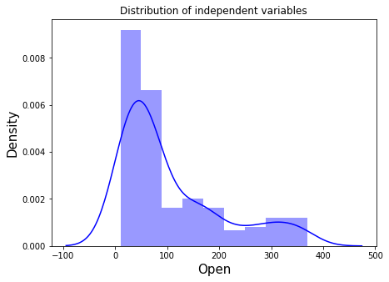
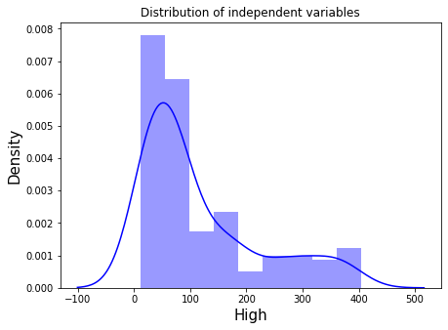
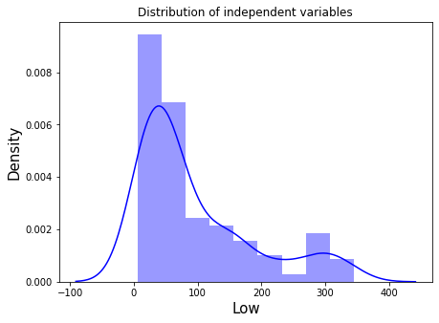
Distribution of Open, High & Low Price of a stock
Opening price, high price, and low price distribution are all right skewed.

Slide 11
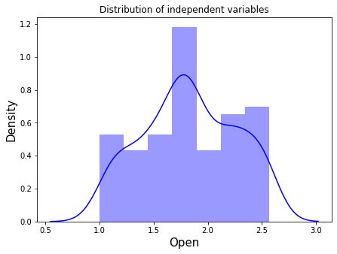
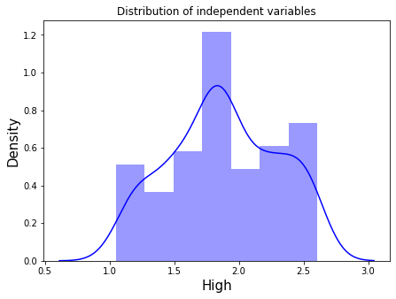
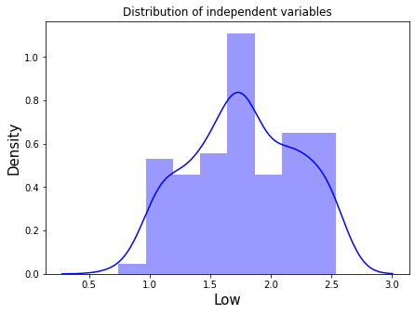
Distribution of Open, High & Low Price of a stock after Log Transformation
The log transformation was applied to all independent variable distributions to convert them to a nearly normal distribution.

Slide 12
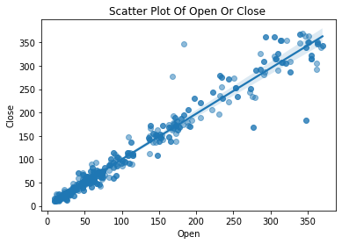
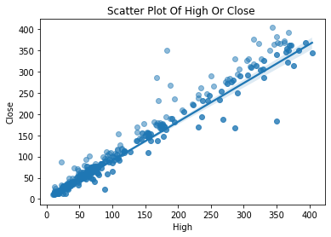
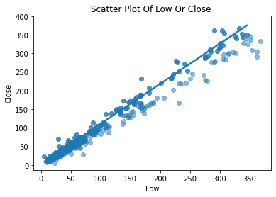
Bivariate Analysis Plots
The relationship between the dependent and independent variables can be observed to be highly correlated through the use of a scatter plot.

Slide 13
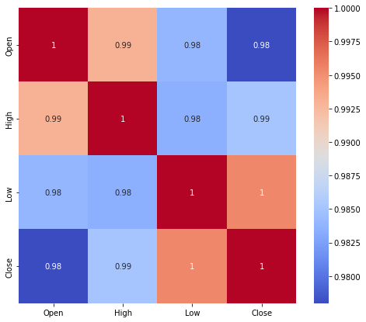
Correlation Between the Variables
The high correlation between the independent variables as found from above result, causes multicollinearity.
For model fitting and prediction, high multicollinearity is undesirable because even a small change in any independent variable can produce wildly unpredictable results.

Slide 14
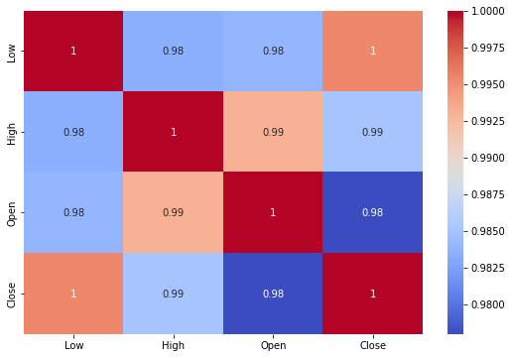
Correlation And VIF Analysis
A variance inflation factor (VIF) is a measure of the amount of multicollinearity in regression analysis. Multicollinearity exists when there is a correlation between multiple independent variables in a multiple regression model.
Variables VIF
0 Open 175.185704
1 High 167.057523
2 Low 71.574137
Any variable with a VIF o more than 5 is typically regarded as multicollinear. The general rule is to drop the variable with the highest VIF, but you can choose the variable to be eliminated depending on business logic. In this case all the feature are equally significant here.

Slide 15
MODEL BUILDING
Splitting data in Train and Test set
Data splits into training dataset and testing dataset.
Training dataset is for making algorithm learn and train model.
Test dataset is for testing the performance of train model.
Here 80% of data taken as training dataset & remaining 20% of dataset used for testing purpose.

Slide 16
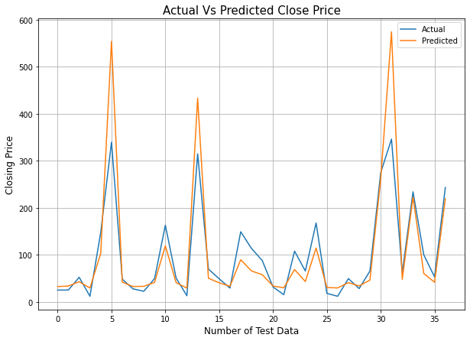
Linear Regression
One of the simplest and most widely used Machine Learning techniques is linear regression.
Linear regression is a statistical method that is used for predictive analysis. It is defined as an algorithm that provides a linear relationship between an independent variable and a dependent variable to predict the outcome of future events.
EVALUATION METRICS
MSE | RMSE | MAE | MAPE | R2 SCORE
0.0316 | 0.1777 | 0.1513 | 0.0954 | 0.8226

Slide 17
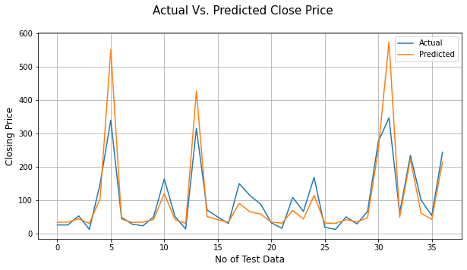
Lasso Regression
Lasso regression is linear regression, but it uses a technique called "shrinkage" where the coefficients of determination shrink towards zero.
It allows to shrink or regularize coefficients to avoid overfitting and make them work better on different datasets.
This type of regression is used when the dataset shows high multicollinearity or when you want to automate variable elimination and feature selection. This method performs L1 regularization.
EVALUATION METRICS
MSE | RMSE | MAE | MAPE | R2 SCORE
0.032 | 0.179 | 0.1523 | 0.0962 | 0.82

Slide 18
Cross Validation
Cross-validation is a statistic method used to estimate the performance (or accuracy) of machine learning models.
It is used to protect against overfitting in a predictive model, particularly in a case where the amount of data may be limited.
In cross-validation, we make a fixed number of folds (or partitions) of the data, run the analysis on each fold, and then average the overall error estimate.

Slide 19
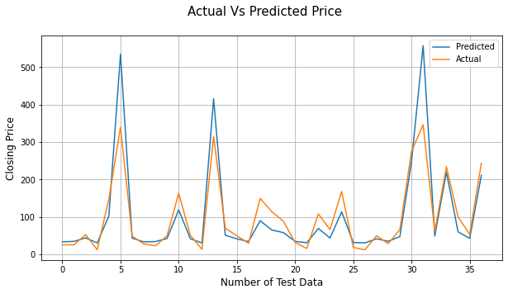
Lasso Regression(After Cross Validation)
EVALUATION METRICS
MSE | RMSE | MAE | MAPE | R2 SCORE
0.0322 | 0.1795 | 0.1528 | 0.0968 | 0.819

Slide 20
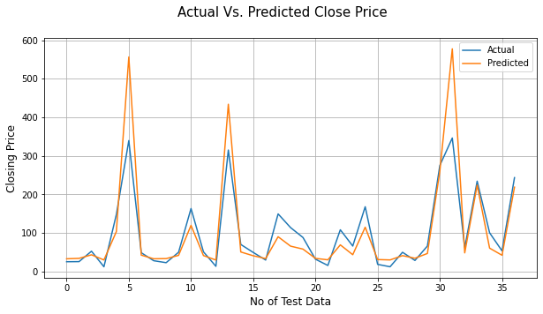
Ridge Regression
Any data that exhibits multicollinearity can be analysed using the model tuning technique known as ridge regression.
This technique carries out L2 regularisation.
Predicted values differ much from real values when the problem of multicollinearity arises, least-squares are unbiased, and variances are significant.
EVALUATION METRICS
MSE | RMSE | MAE | MAPE | R2 SCORE
0.0317 | 0.1779 | 0.1514 | 0.0955 | 0.8221

Slide 21
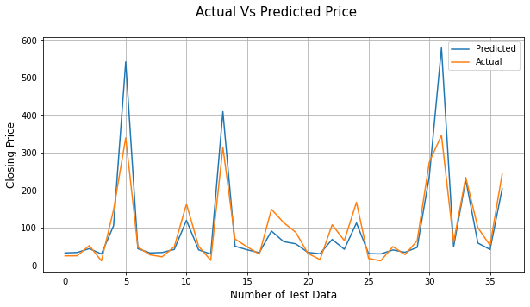
Ridge Regression(After Cross Validation)
EVALUATION METRICS
MSE | RMSE | MAE | MAPE | R2 SCORE
0.0325 | 0.1804 | 0.1531 | 0.0968 | 0.8172

Slide 22
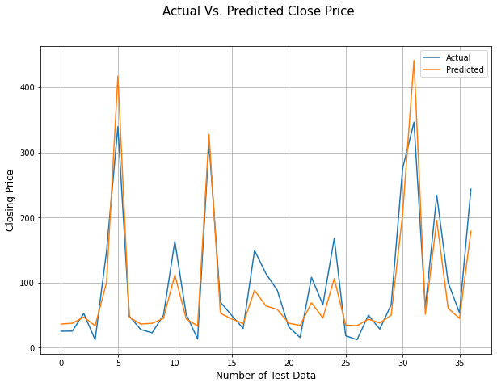
Elastic Net Regression
Elastic net linear regression uses the penalties from both the lasso and ridge techniques to regularize regression models.
The technique combines both the lasso and ridge regression methods by learning from their shortcomings to improve the regularization of statistical models..
EVALUATION METRICS
MSE | RMSE | MAE | MAPE | R2 SCORE
0.0364 | 0.1908 | 0.1574 | 0.1024 | 0.7955

Slide 23
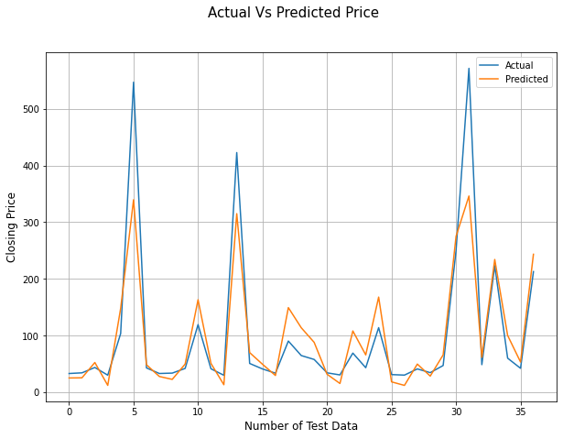
Elastic Net Regression(After Cross Validation)
EVALUATION METRICS
MSE | RMSE | MAE | MAPE | R2 SCORE
0.0321 | 0.1791 | 0.1524 | 0.0963 | 0.8198

Slide 24
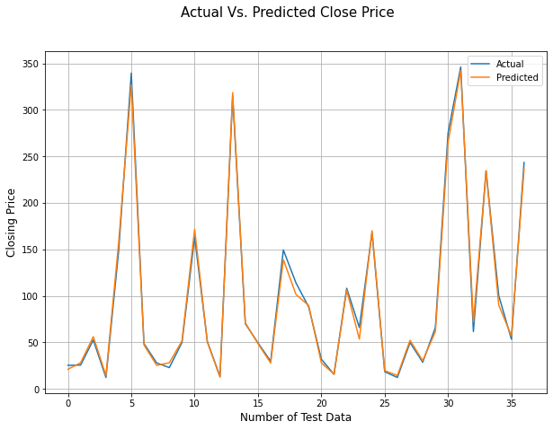
XG Boost Regression
XG Boost stands for “Extreme Gradient Boosting”. XG Boost is a powerful technique for building supervised regression models.
One can determine the accuracy of this statements (XG Boost) by understanding its objective function and base learners.
The objective function includes a regularisation term and a loss function. It offers details on how far the model's predictions deviate from the actual values, or the difference between actual and predicted values.
EVALUATION METRICS
MSE | RMSE | MAE | MAPE | R2 SCORE
0.0016 | 0.0394 | 0.0303 | 0.0196 | 0.9913

Slide 25
CONCLUSION
1.The tendency of Yes Bank's stock's Close, Open, High, and Low prices increased until 2018 and then
unexpectedly decreased after fraud case of Rana Kapoor.
2. The target variable is highly dependent on input variables.
3. Each independent variable has a strong correlation with the others (Multicollinearity).
4. The R squared values for linear, lasso, and ridge regressions are nearly identical.
5. On the basis of RMSE(Root Mean Square Error) and MAPE(Mean Absolute Percentage Error), we compared 5
models (Linear Regression, Lasso Regression, Ridge Regression, Elastic Net Regression, and XG Boost Regression).
6. The dependent variable ( Closing Price ) and the independent variables (High, Low, and Open) have a direct correlation.
7. With the lowest RMSE (0.0394) and MAPE (0.0196) as well as the highest R2 score (0.9913), XG-Boost Regression is the best model.

Slide 26
THANK YOU

